Slide 1
EE 74099 / EN 74099 Research Project
Project Title: Vision Based Navigation System for Indoor Robots
Progress Presentation – 4
18.05.2019
Under the Supervision of : Dr. WGCW Kumara
And Eng. Abdul Cadar
Team Members:
ANFM. Begum - SEU/IS/13/EG/002
GSU. Ahmadh - SEU/IS/13/EG/011
IIS. Prema Sri - SEU/IS/13/EG/032

Slide 2
We are now mainly working in two parts.
Hardware build of the robot
Navigation System

Slide 3
As we already reported in the previous progresses, we managed to come to an extent where we are now able to transfer a coordinate from a camera image to a real 2D map.
When we complete the part of detecting and tracking the robots in the image, we will then be able to plot the coordinates on the Map drawn.

Slide 4
At this point, it requires a lot of reading on Object detection and tracking. There are many recommended ways to achieve this. Traditional image processing methods are being outperformed by Deep learning. Now we need to study about the possible methods and to decide on which way to move with.

Slide 5
Imesh’s proposed design for the Robot will be as follows in the next slides,

Slide 6
Robot-building…

Slide 7
A mobile robot needs locomotion mechanisms that enable it to move unbounded throughout it’s environment.
Mobile robots generally locomote either using wheeled mechanisms, or using a small number of articulated legs.
Legged locomotion requires higher degrees of freedom and therefore greater mechanical complexity than wheeled locomotion.
Wheels, in addition to being simple, are extremely well suited to flat ground.

Slide 8
There are four major wheel classes.
Standard wheel.
castor wheel.
Swedish wheel.
Ball or spherical wheel.

Slide 9
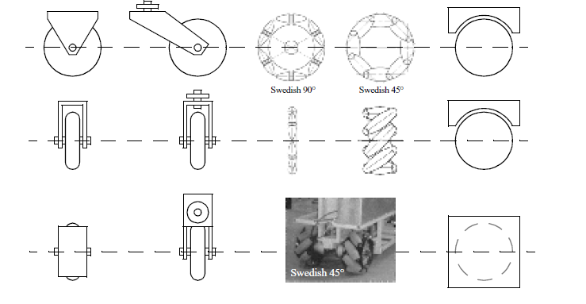
1
2
3
4
Source : Introduction to Autonomous Mobile Robots - Siegwart Nourbakhsh (Figure 2.19)

Slide 10
There is a very large space of possible wheel configurations when considers possible techniques for mobile robot locomotion.
The choice of wheel types for a mobile robot is strongly linked to the choice of wheel arrangement, or wheel geometry.
One of the cost effective solution for mobile robot navigation is differential drive systems.

Slide 11
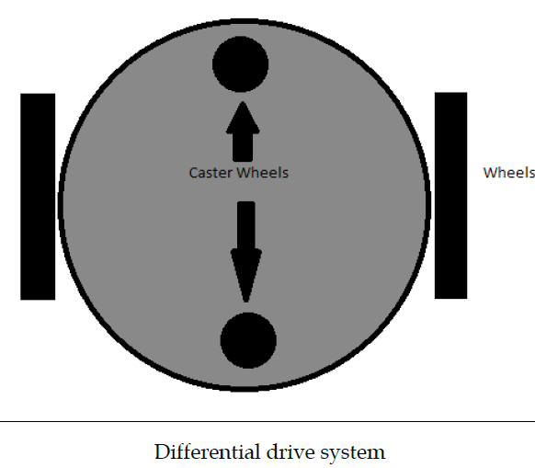
Source : semanticscholor.org

Slide 12
The differential drive robot consists of two wheels mounted on a common axis controlled by two separate motors.
This drive mechanism is mainly indented for indoor navigation.
There are two caster wheels ensures the stability and weight distribution of the robot.

Slide 13
Some of out preliminary works on object detection is in the following few slides…

Slide 14
Object tracking
Two main procedures are used in object tracking
Color filtering
Contour finding

Slide 15
Steps followed in coding
Convert image from BGR to HSV
Filter the pixels between minimum and maximum threshold
Morphological Operations (Dilate and Erode)
Track the (x,y) coordinates of object.

Slide 16
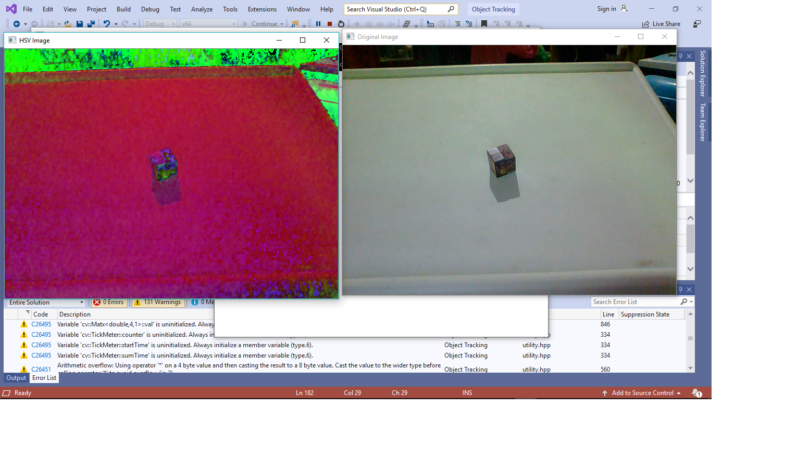
Original image is converted from BGR to HSV
Figure 1: BGR image
Figure 2: HSV image

Slide 17
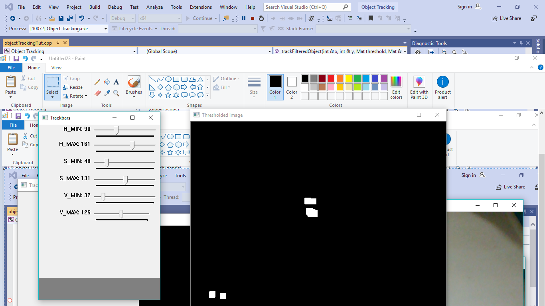
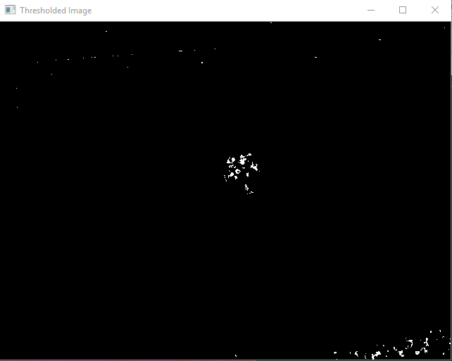
Threshold image is obtained from HSV adjustment
Figure 2: HSV values
Figure 3: Threshold Image

Slide 18
Dilate and erode functions are used to reduce noise
Figure 1: Adjusted HSV values
Figure 1: Threshold Image after morphological operations

Slide 19
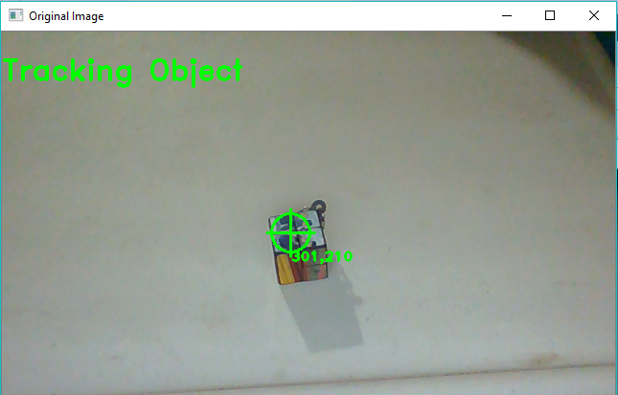
Object is tracked by largest contour
Figure 4: Tracked object

Slide 20
Thank You

